Slide 1
BFCC - Baltic Fracture Competence Centre
Implementation of a Transnational Fracture Registry
Prof. Dr. Wolfgang Hoffmann, University Medicine Greifswald
8th EUSBSR Forum, Berlin
14/06/2017

Slide 2
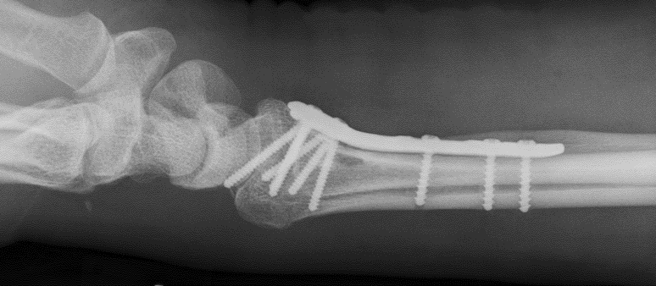
Source: private
Fostering innovation for better fracture management

Slide 3
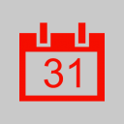
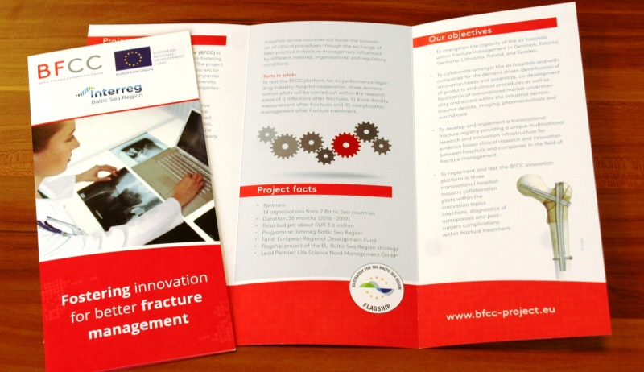
Project in a nutshell
13 organisations from seven countries round the Baltic Sea
Duration: 36 months (2016 – 2019)
Total budget: EUR 3.6 million
Baltic Sea Region Programme 2014-2020
Flagship project of the EU strategy
Notes:
In ageing societies, the need for innovative products and clinical procedures for fracture treatment is increasing due to more age related fractures and comorbidities such as osteoporosis or post surgery complications like infections. Innovations must reduce the total cost of care or clearly improve the quality of care at a justifiable cost and bring new solution to outstanding medical challenges. The industrial sectors for innovation are broad covering implants, imaging, pharmaceuticals, wound care or single use surgery devices. These trends already led to a rising demand for innovation and investments e.g. by the European medical technology industry which increased their R&D actors in the innovation process helping to identify needs and to ensure user oriented products. Around 50% of new products are initiated by clinicians. Accordingly, companies in the BSR spend 11% from 2012 to 2013. At the same time, research and innovation (R&I) within fracture management is facing various challenges in understanding clinical needs and effectiveness, reducing costs of innovation and time to market. Clinicians and companies often lack insight into the total costs of care, the effectiveness of treatment and the causes of adverse health outcome in hospitals. To overcome these challenges, clinical fracture registries can provide evidence in the clinical “real world” and reveal needs and potentials for innovation. Further, clinicians and hospitals are important SR need direct access to hospitals and clinicians for collaboration within needs assessment, preclinical research, product development, clinical trials, postmarket follow up studies or health technology assessment. Moreover, an intensified collaboration between clinicians across hospitals and countries benefits the innovation of clinical procedures through the exchange of best practice, influenced by different national, organisational and regulatory conditions. Finally, successful innovation is driven by fast market access across countries which can be facilitated by collaboration between clinicians and companies, which is especially relevant for startups and SMEs in the BSR.
The BFCC responds to these challenges by aiming at accelerated and effective transnational collaboration for innovation within fracture management in the BSR. The BFCC develops and implements a transnational fracture registry platform of 6 hospitals from DE, DK, LT, PL, EE and SE, allowing a comparison of the process and outcome quality across institutions and countries. This transnational R&I infrastructure fosters the evidencebased identification of clinical bestpractice and needs for innovation. BFCC establishes a transnational collaboration platform between hospitals and industry, which will be tested in 3 transnational pilots, with 6 hospitals and 4 companies involved. As part of the EUSBSR flagship project HealthRegion the project opens the R&I infrastructure and all identified innovation needs to all BSR companies.

Slide 4
Fractures
Hospital stay – Fractures are the 6. most common reason
*except Denmark
Source: http://ec.europa.eu/eurostat/statistics-explained/index.php/ File:Hospital_discharges_of_in-patients,_by_disease_injury,_2013_(per_100_000_inhabitants)_Health2015B.png
Notes:
Starting point for BFCC is the fact that fractures are still one of the top reasons for a hospital stay today.

Slide 5
Fractures
will increase
Sources: Krankenhausstatistik Diagnosedaten der Patienten und Patientinnen in Krankenhäusern, Statistisches Bundesamt and http://www.statbank.dk/INDP01
Notes:
…and with an ageing society – as we are facing here in the Baltic Sea Region – factures will occure even more often.

Slide 6
Challenges
Demographic Change // ageing society > more age-related fractures
Unsolved medical issues // existing post-surgery complications > infections; non-unions
EU data protection conformance
Understanding clinical needs and effectiveness in real clinical world
Notes:
Ageing leads to higher risk for fractures.
Prevalence of fractures will exponentially increase with ageing society (in terms of prevalence and health costs), problem will be magnified.
We need to individualise treatment and pathways for a better health outcome and economy / health care costs
Selection of treatment must better and more cost-effective.

Slide 7
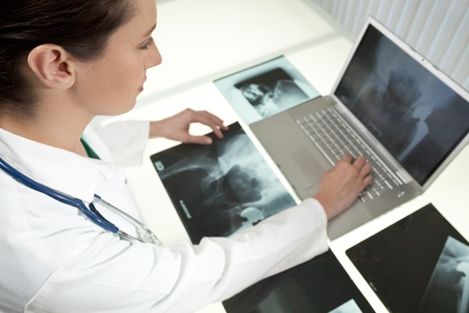
BFCC // Baltic Fracture Competence Centre
Fostering innovation for better fracture management
Project objectives
Improve health outcome
Reduce hospital stay
Strengthen competitiveness and support growth of BSR companies
Answer research questions about fracture-related complications etc.
Solutions
Establish research and innovation network in fracture management
Analyse clinical data from transnational registry
Foster hospital-industry cooperation for new product and service development
© SpotmatikLtd - shutterstock

Slide 8
Project outcome
Transnational collaboration
4 new fracture registries
Transnational fracture registry platform
Innovation Reports
Transnational R&I infrastructure
3 transnational pilots (diagnostics, infections, complications)
Education and training
Notes:
- Initiate transnational collaboration for innovation within fracture management between hospitals and industry.
- Implementation of new fracture registries in 4 hospitals (DE; PL; LT; EE).
- Development of a transnational fracture registry platform from 6 hospitals (DE; PL; LT; EE; SE; DK).
- Comparison of the clinical process and outcome quality and develop 2 innovation reports.
- 3 transnational pilots (diagnostics, infections, complications).
- Build up transnational R&I infrastructure.
- Support education and training of clinicians and industry.
In ageing societies, the need for innovative products and clinical procedures for fracture treatment is increasing due to more age related fractures and comorbidities such as osteoporosis or post surgery complications like infections. Innovations must reduce the total cost of care or clearly improve the quality of care at a justifiable cost and bring new solution to outstanding medical challenges. The industrial sectors for innovation are broad covering implants, imaging, pharmaceuticals, wound care or single use surgery devices. These trends already led to a rising demand for innovation and investments e.g. by the European medical technology industry which increased their R&D actors in the innovation process helping to identify needs and to ensure user oriented products. Around 50% of new products are initiated by clinicians. Accordingly, companies in the BSR spend 11% from 2012 to 2013. At the same time, research and innovation (R&I) within fracture management is facing various challenges in understanding clinical needs and effectiveness, reducing costs of innovation and time to market. Clinicians and companies often lack insight into the total costs of care, the effectiveness of treatment and the causes of adverse health outcome in hospitals. To overcome these challenges, clinical fracture registries can provide evidence in the clinical “real world” and reveal needs and potentials for innovation. Further, clinicians and hospitals are important SR need direct access to hospitals and clinicians for collaboration within needs assessment, preclinical research, product development, clinical trials, postmarket follow up studies or health technology assessment. Moreover, an intensified collaboration between clinicians across hospitals and countries benefits the innovation of clinical procedures through the exchange of best practice, influenced by different national, organisational and regulatory conditions. Finally, successful innovation is driven by fast market access across countries which can be facilitated by collaboration between clinicians and companies, which is especially relevant for startups and SMEs in the BSR.
The BFCC responds to these challenges by aiming at accelerated and effective transnational collaboration for innovation within fracture management in the BSR. The BFCC develops and implements a transnational fracture registry platform of 6 hospitals from DE, DK, LT, PL, EE and SE, allowing a comparison of the process and outcome quality across institutions and countries. This transnational R&I infrastructure fosters the evidencebased identification of clinical bestpractice and needs for innovation. BFCC establishes a transnational collaboration platform between hospitals and industry, which will be tested in 3 transnational pilots, with 6 hospitals and 4 companies involved. As part of the EUSBSR flagship project HealthRegion the project opens the R&I infrastructure and all identified innovation needs to all BSR companies.

Slide 9
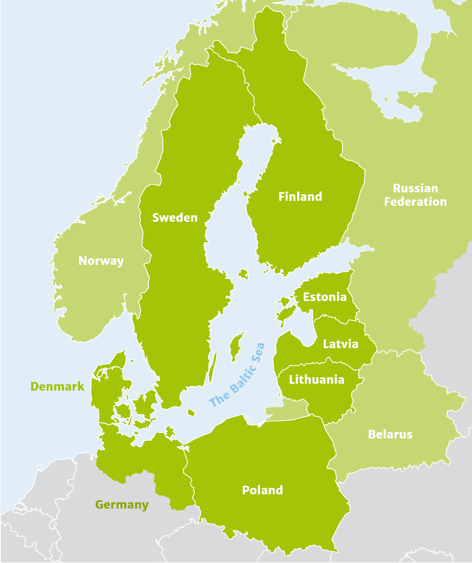
Transnational fracture registry
Hospital / Existing fracture registry
Sahlgrenska University Hospital
Hospital / Novel fracture registry
University Medical Center Schleswig-Holstein
Lithuania University of Health Science
University Hospital Krakow
University of Tartu
Research institution / IT infrastructure
University Medicine Greifswald
Patient
www
Registry
PSN (pseudonym)
pseudonymised MDAT (Medical data)
MDAT + IDAT
@ Interreg Baltic Sea Region Programme

Slide 10
Target groups
Hospitals
Medical professionals
Companies
Clinical research
Health authorities and health insurances
Medical societies
Beneficial group: Patients
Notes:
What are the main groups targeted by BFCC…
Hospitals interested in setting up quality benchmarks with other hospitals or countries (positive and negative outliers), as well as in reducing complications and costs.
Medical professionals interested in promoting further professional development in fracture treatment, benchmark with other professionals and benchmark of different treatment methods.
Companies interested in innovation needs and potentials, managing product complaints and recall, in perspective health economic modelling, accelerating market access and in efficient post-market surveillance
Clinical research interested in collecting real life data, mirroring real life conditions, having access to a huge amount of patients in order to be able to generate hypothesis and collect epidemiological data.
Health authorities and health insurances interested in the potentials for cost reductions, the epidemiology of fractures and in planning of health care provision.
Medical societies interested in participating in new developments in their specific field of interest.

Slide 11
Project Contact
Dr Anna-Winona Struck
Life Science Nord Management GmbH (Lead Partner)
Legienstraße 40
24103 Kiel, Germany
+49 (431) 90 88 58 28
struck@lifesciencenord.de
www.lifesciencenord.de
Data Management
Prof. Dr. med. Wolfgang Hoffmann, MPH
University Medicine Greifswald
Institute for Community Medicine
Ellernholzstr. 1-2
17489 Greifswald, Germany
+49 (3834) 86 7750
wolfgang.hoffmann@uni-greifswald.de
Project Management
Ralf Duckert,
DSN - Connecting Knowledge
www.bfcc-project.eu

